Slide 1
Jakirul Islam
Green university of Bangladesh

Slide 2
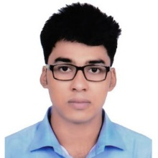
My self
My self
My name is jakirul .i am a student of class bse in cse green
university of Bangladesh .I am not bad student but
unforcuntly my result not good .because properly use for
my brain in the exam hall . So , its simple my result is bad .
She result my life effected hold life . Because admition
Point not englut mark . But I promise second time university
admission test properly user my logic .
Then my daily life routine follow regularly .
I am sure success in my life .
Please pray for me . And I got will success in my life .
Three step rule follow regularly . Follow this next slide .

Slide 3

Rule 1 :
regularly early good morning on this bed at 5 a clock in this time .
Then started study in reading room .
At Last 5 hours continues study and only study .
No phone , no computer use .

Slide 4
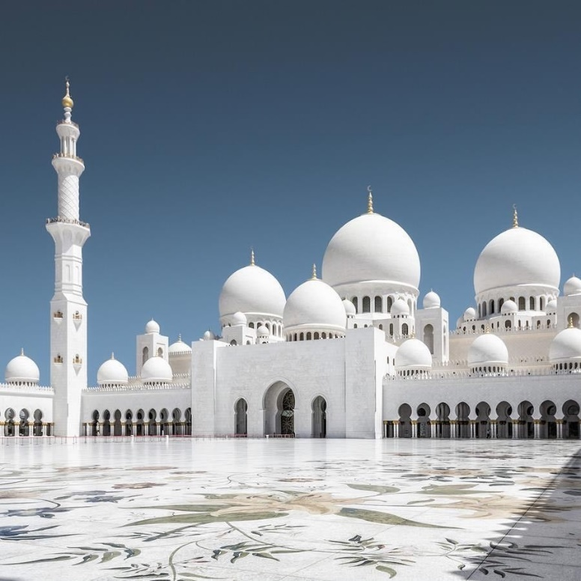
Rule 2 :
as a Muslim so , my duty regularly mosque and pray for parents . Allah we get help me always . So this process
Continues I hope all off well .

Slide 5
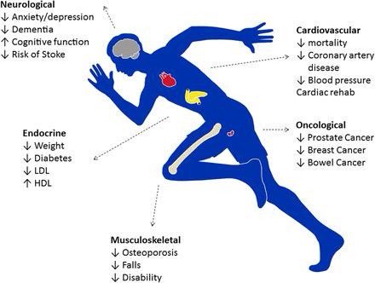
Rule 3:
physical exercise regularly and continues .
Because exercise is very most important in my health .
So , follow this system regularly . At last 30 minutes .

Slide 6
Thanks

